Slide 1

Perspectives for RIs in the next phase of EOSC
European Photon and Neutron Community Symposium

Slide 2
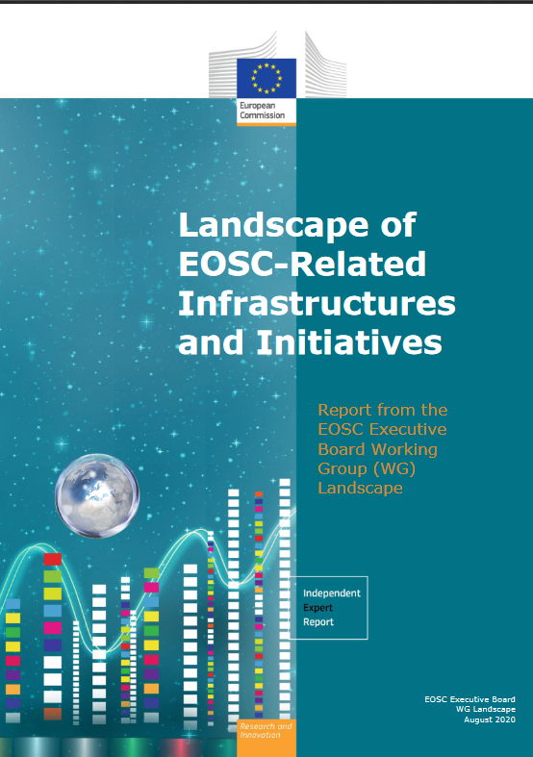
EOSC - Landscape report / Landscape analysis
Published: 2020-09-14
Published: 2020-09-14
Landscape of EOSC Related Infrastructures and Initiatives
1th Validation WKS (27/28. 4. 2020) (EC 14. Sept 2020)
Landscape analysis (DCC)
2nd Validation WKS (28/29. 9. 2020) (EC Nov/Dec 2020)
Country sheets - Survey of the Landscape 2019 and 2020
47 countries - EU MS (27), AC (16), OC (4) and 50 projects
Current state of affairs, OS policies, EOSC readiness
Infrastructures (roadmaps and funding).
Majority of countries planning for Open Science.
Fairly high degree of readiness and awareness of EOSC
Mumber IS considered : DE (986), UK (909), FR (516), NL (306), PL (172), PT (170), …
All Countries reported at least one infrastructure that could be made available (federated) through EOSC.
EUROPEAN EOSC LANDSCAPE IS VERY DIVERSE

Slide 3

Infrastructures as key success factor for EOSC
Infrastructures (IS) – data, e-infras, computing, networking, and RIs (institutional, regional, national, global) serve as major promoters of Open Science, and are as an integrated IS system at equal level fundamental for the creation of EOSC.
IS form critical part of a coherent research ecosystem capable of addressing the major, interdisciplinary challenges (e.g. COVID-19 data platform / dedicated ESFRI WEB pages over 100 RI anti-COVID-actions)
Though the IS ecosystem faces huge diversity across the disciplines and countries, it is horizontally (cross-disciplinary) and vertically interlinked.
The bulk of the EOSC funding (ISs, data and users) will come from nationally supported funders rather than the EC – EOSC Sustainability critical depends on national strategies
Changing National priorities - significant impact on e-Is and RIs – Need for coordination in policies and financial support. Standards for policy, processes and procedures
Diversification of IS portfolio to minimize impact on EOSC federation.
(R)IS AS A PART OF THE CRITiCAL NATIONAL INFRASTRUCTURE

Slide 4
RIs as pivotal for EOSC – link to users
Role of RIs in EOSC – 2nd EOSC – ESFRI workshop / ESFRI`s WP “Making science happen”
producers of huge amount of high-quality data - Key factor for EOSC`s early stage success, inclusiveness, small new communities, long tail of science …
keeping multidisciplinary community aligned - Building an Open science community, developing collaborative and co-creation culture
stimulating interoperability and collaboration across domains – Developing and respecting disciplinary standards
readiness and early response to current crises and challenges – developing cross-disciplinary understanding, metadata framework
several service layers are not well defined – e-services, services directly supporting data driven sciences, software and software archives, but also science driven services, and many others.
definition of a minimum viable national infrastructure will help to ensure that all the relevant IS and components are included (national and EU)
RIs ARE CRITAL FOR EOSC IMPLEMENTATION

Slide 5

Establishing a framework for future collaboration
MS support the domain specific Is and RIs to develop their data repositories and encourage their federation – a backbone EOSC infrastructure at national level
Sharing best practices (of current projects, clusters and pan European infrastructures) will trigger cooperation of IS‘s repositories in all areas (data quality, tracking system, metadata standards, technical standards, policy requirements, existing mechanisms and networks, certification mechanisms, etc.)
Self-organization / Cluster projects could provide existing datasets and associated science domain specific data services developed by RIs to EOSC - Coordination of stakeholders / users
Monitoring of IS will help EOSC implementation and development => KPIs adjusted to the domain, particular IS => assessment of EOSC readiness and participation. Following RACER criteria = Relevant, Accepted, Credible, Easy to monitor, Robust
Monitoring of national OS and data policies development will help the long terms EOSC development and sustainability
Visibility of Open Science and Open Data outputs => good practice examples
COLABORATIVE NETWORK TO MEET SOCIO-ECONOMIC NEEDS

Slide 6

Thank you for your attention.

